Slide 1
Tech Comm Trends
PROVIDING VALUE AS A GENERALIST IN A SEA OF SPECIALISTS

Slide 2
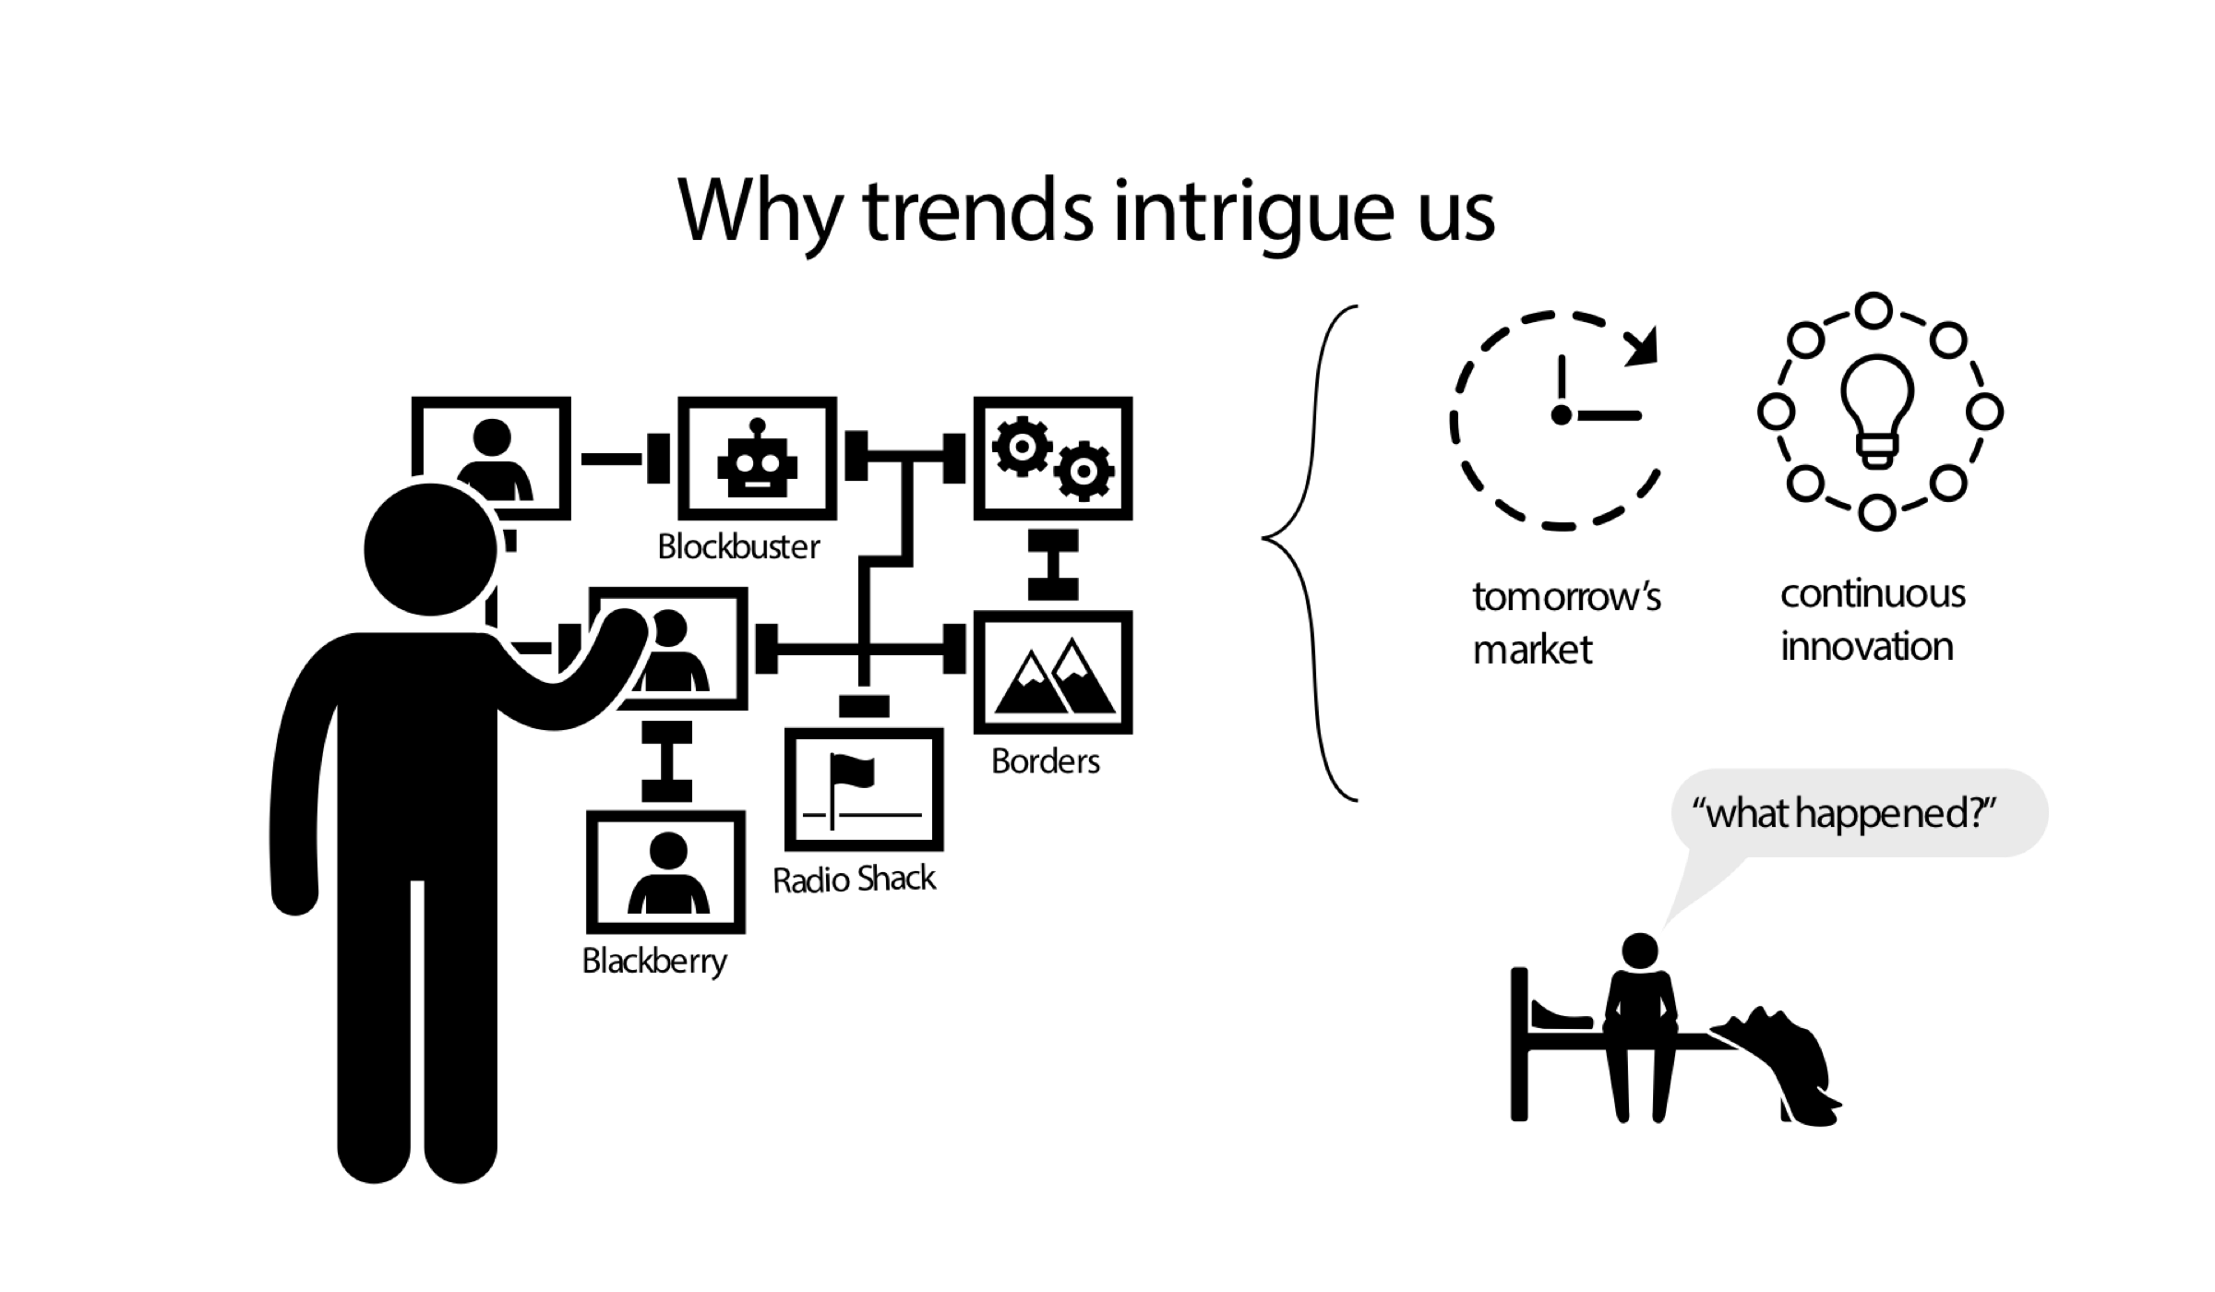
Why trends intrigue

Slide 3

The impact of UX and the need for docs

Slide 4
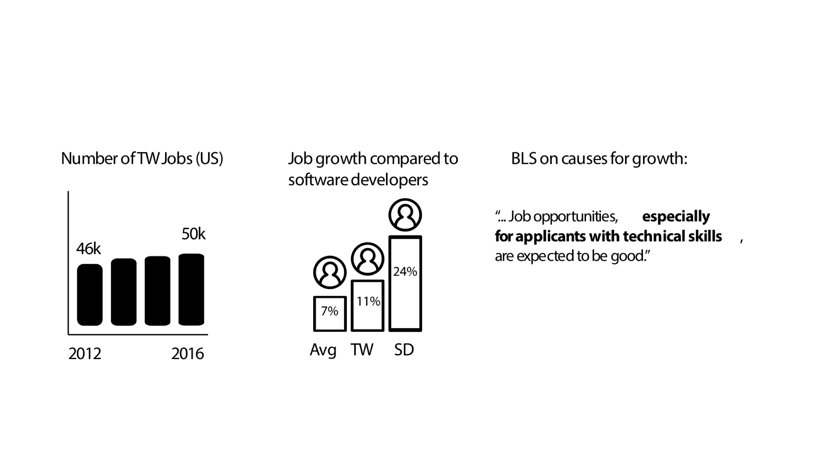
Evaluating trends based on BLS data

Slide 5
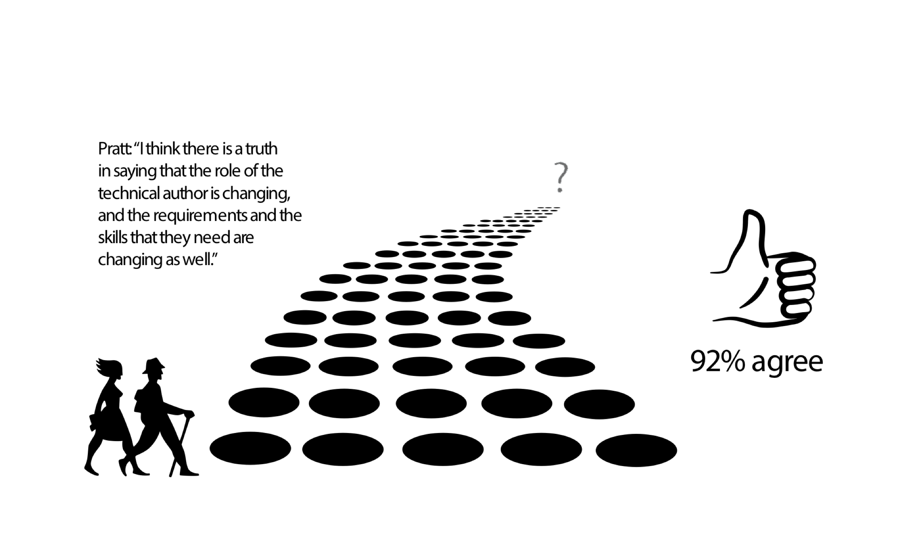
An “evolution” of roles, but towards what?

Slide 6
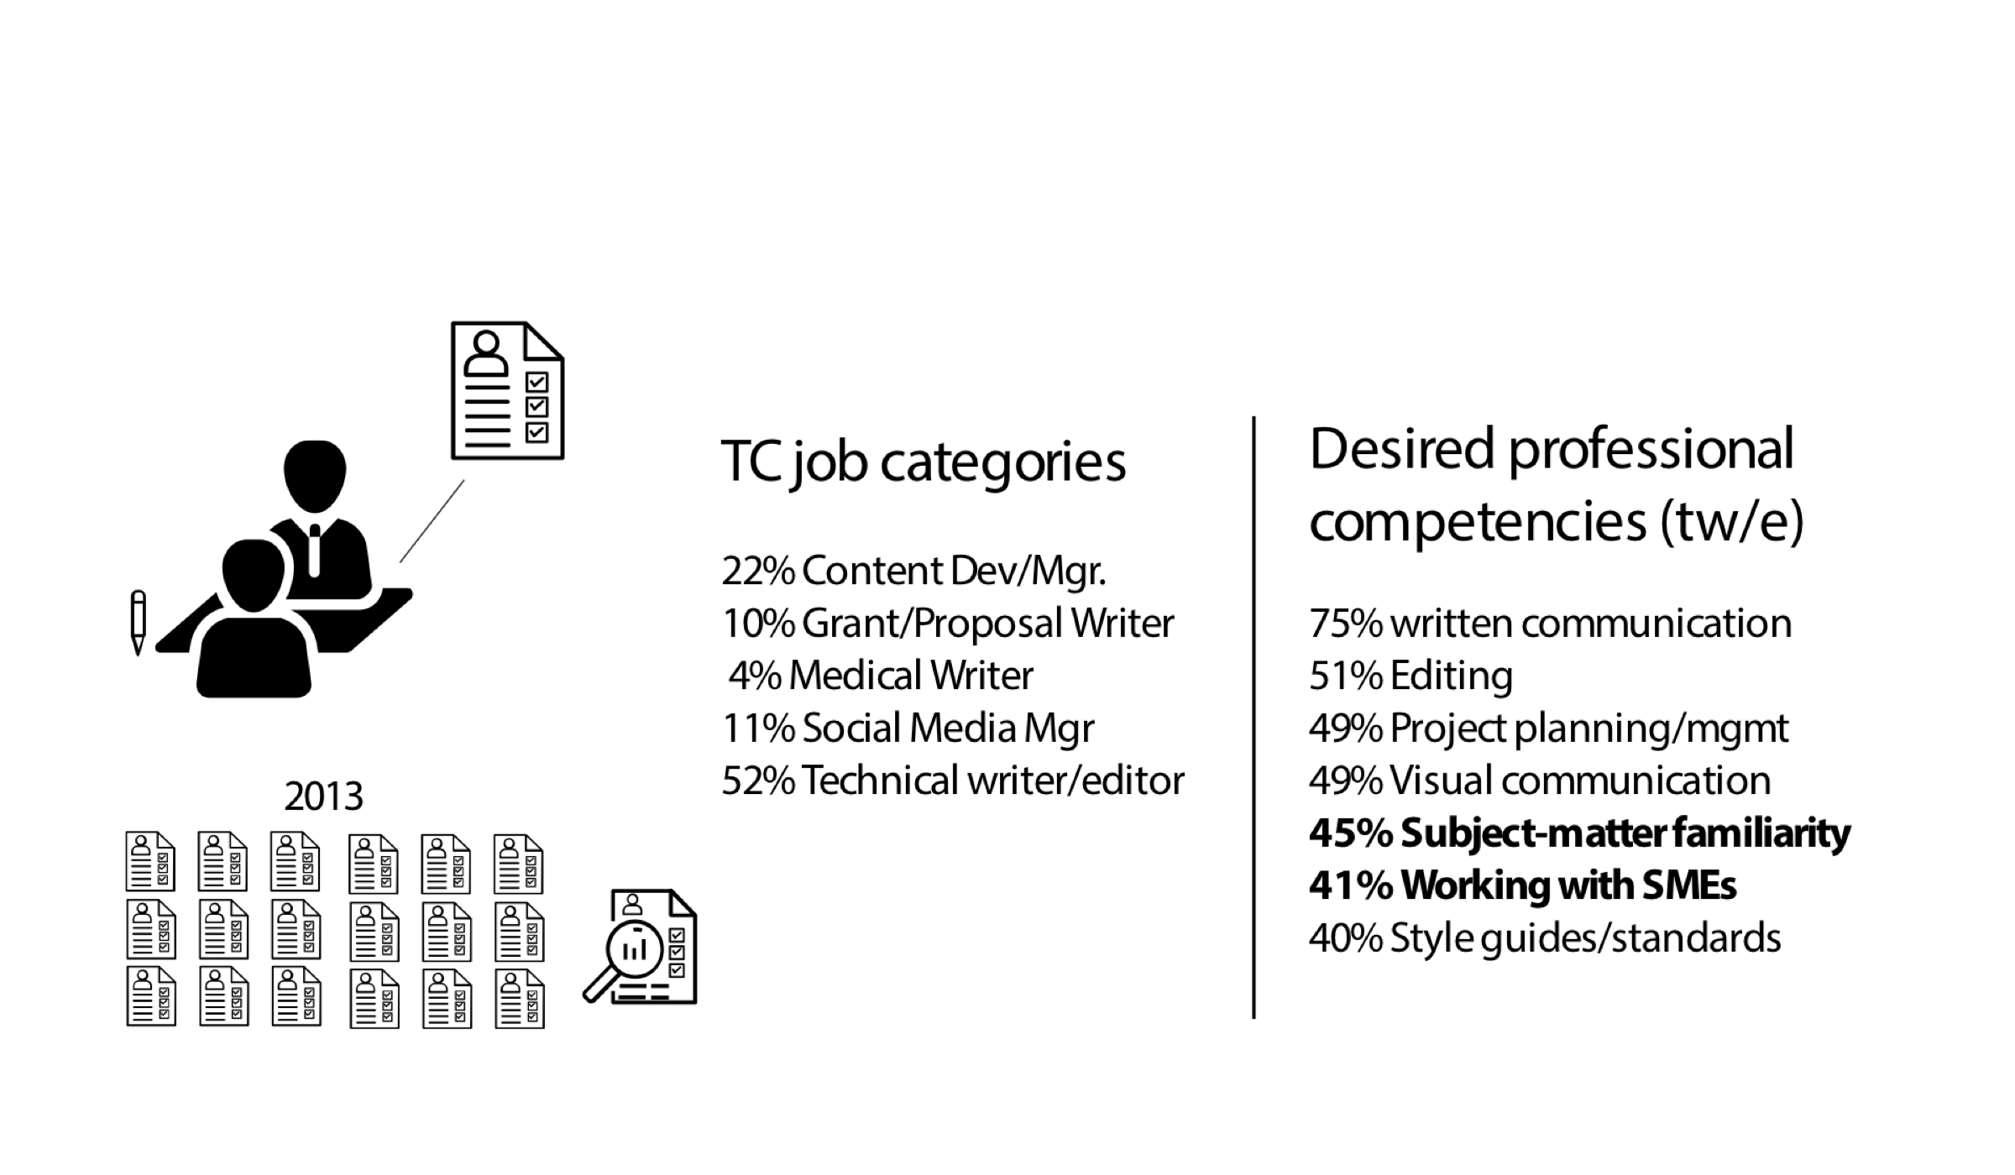
Looking at job ads to extrapolate trends

Slide 7
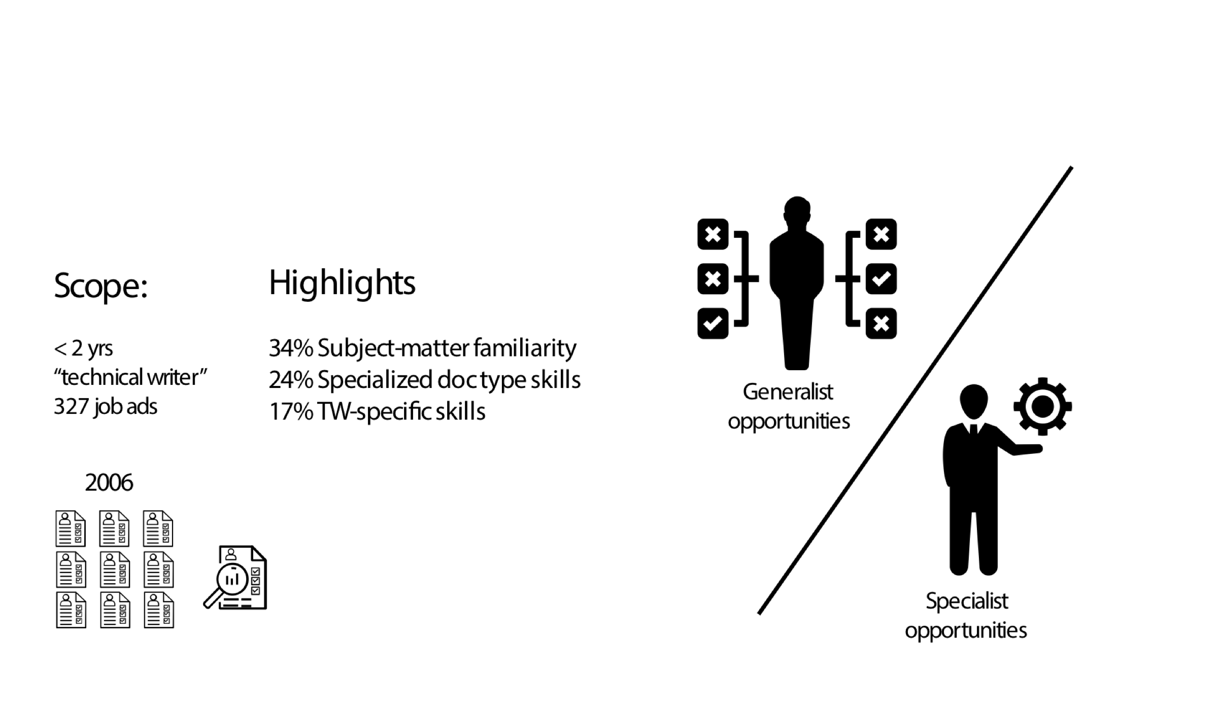
Looking at job ads for trends (cont.)

Slide 8
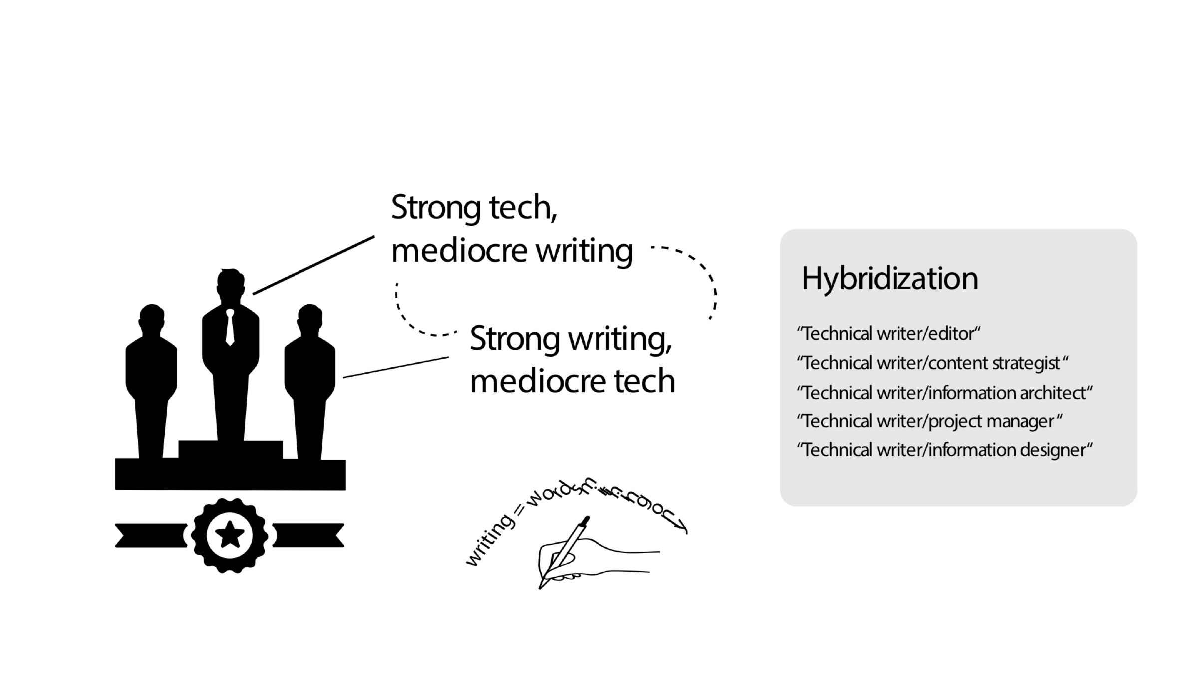
Tech knowledge valued more than writing skills

Slide 9
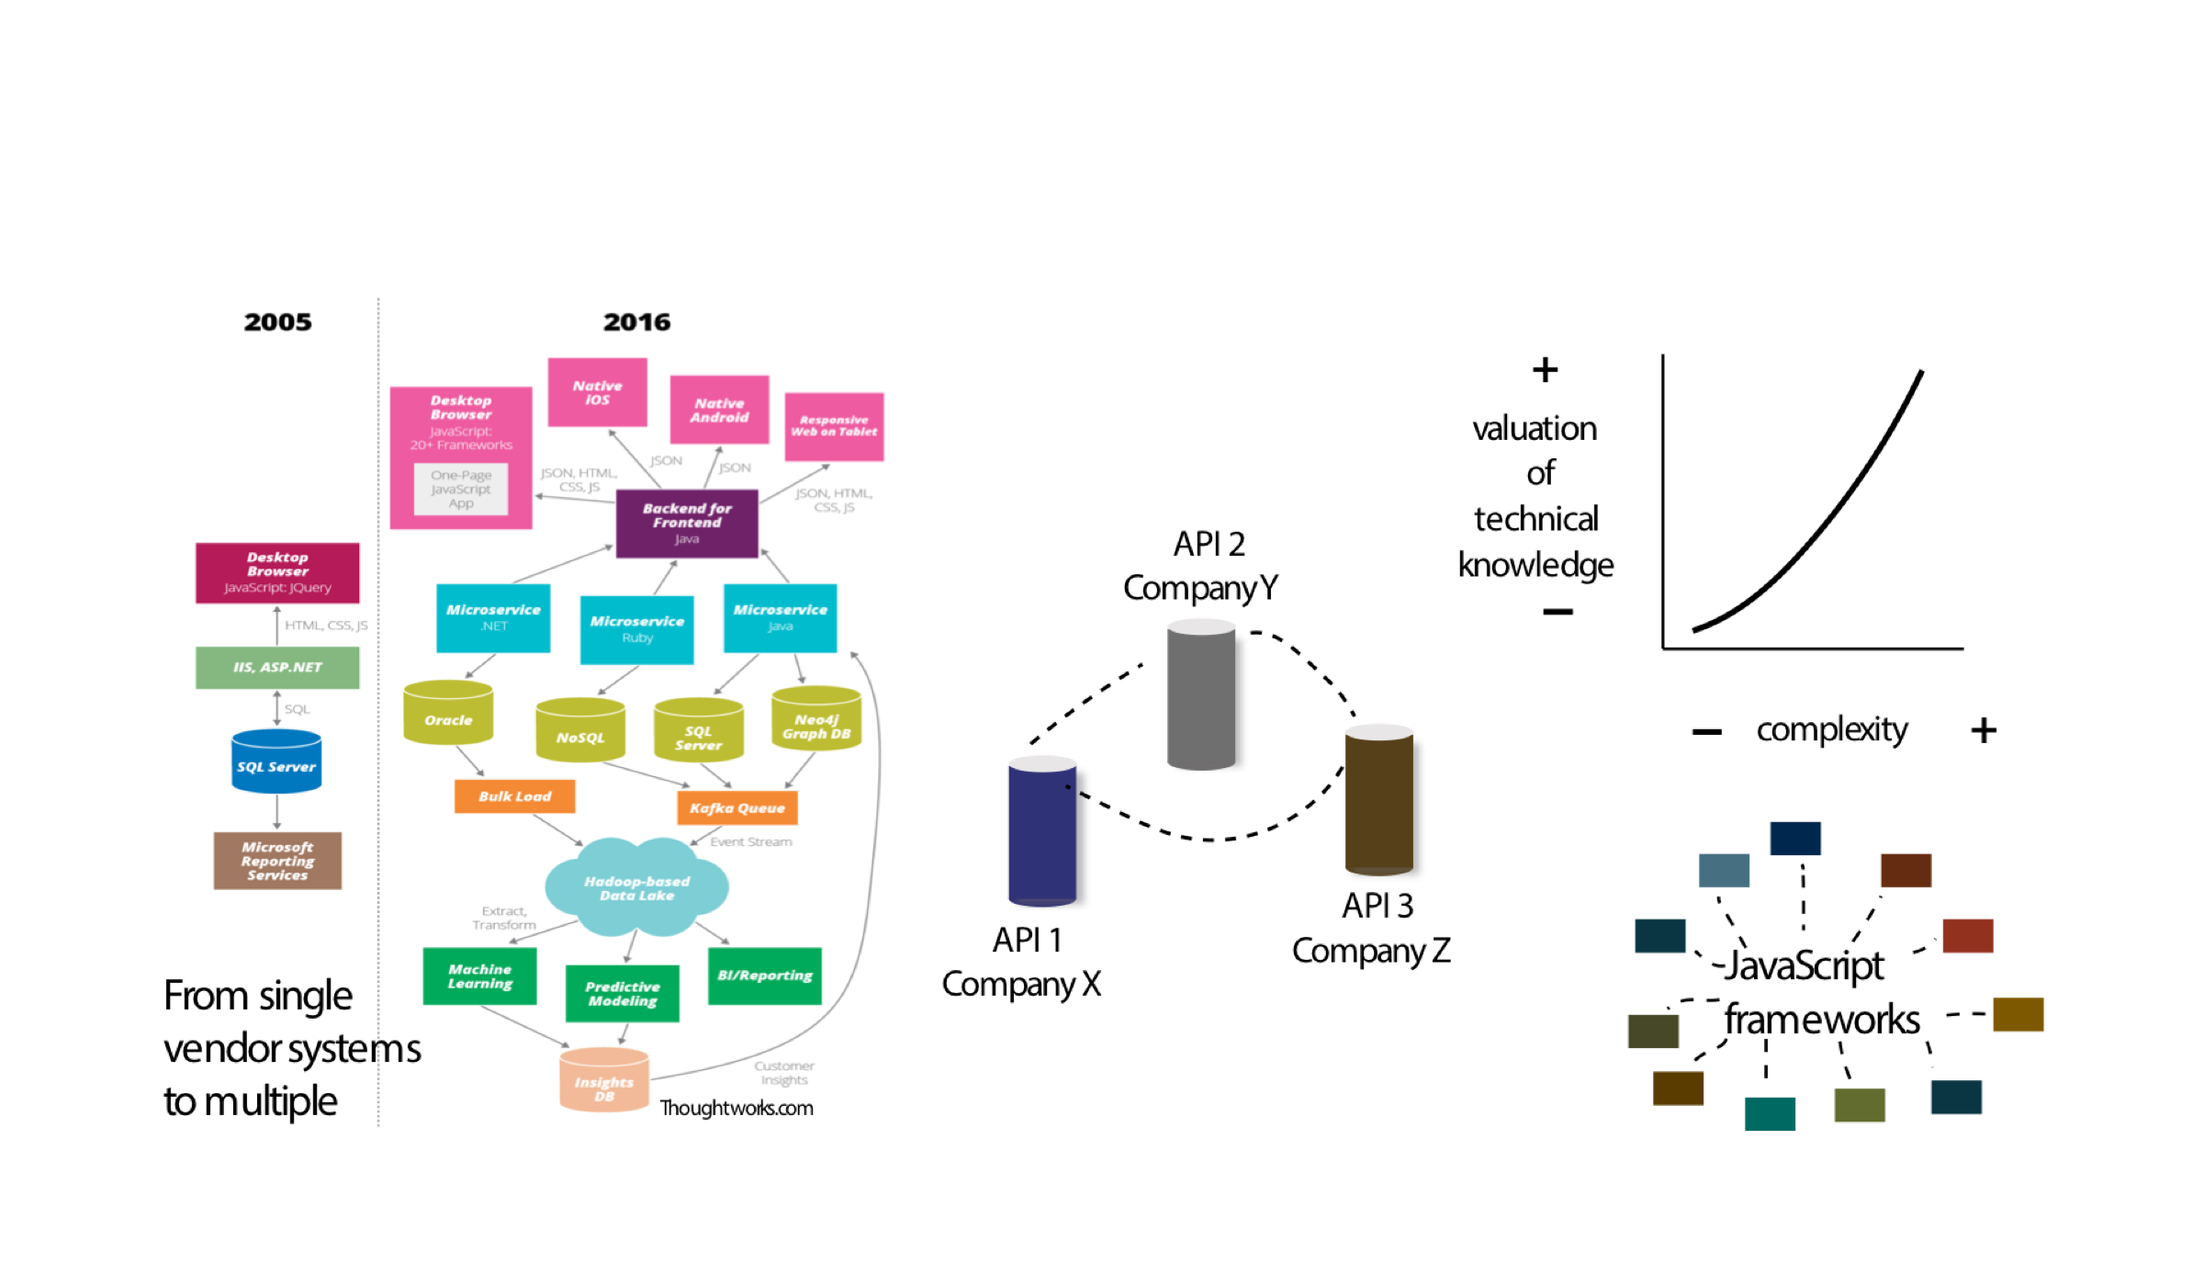
Complexity drives the value of tech knowledge

Slide 10

Simpler on frontend, complex underneath

Slide 11

Trying in vain to keep up with the pace of technology

Slide 12
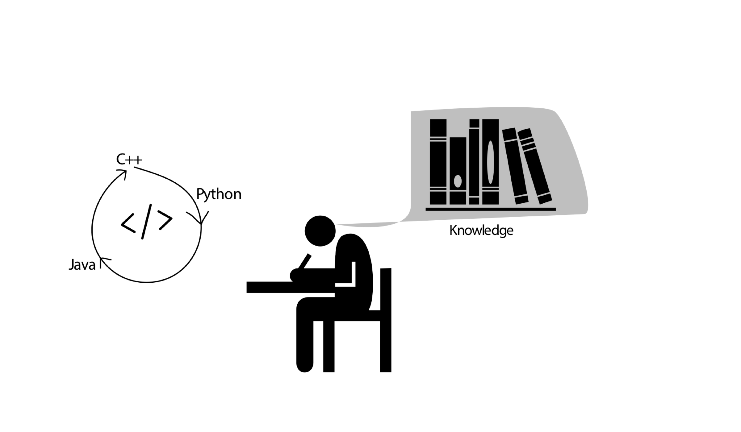
Technical knowledge is essential to writing

Slide 13
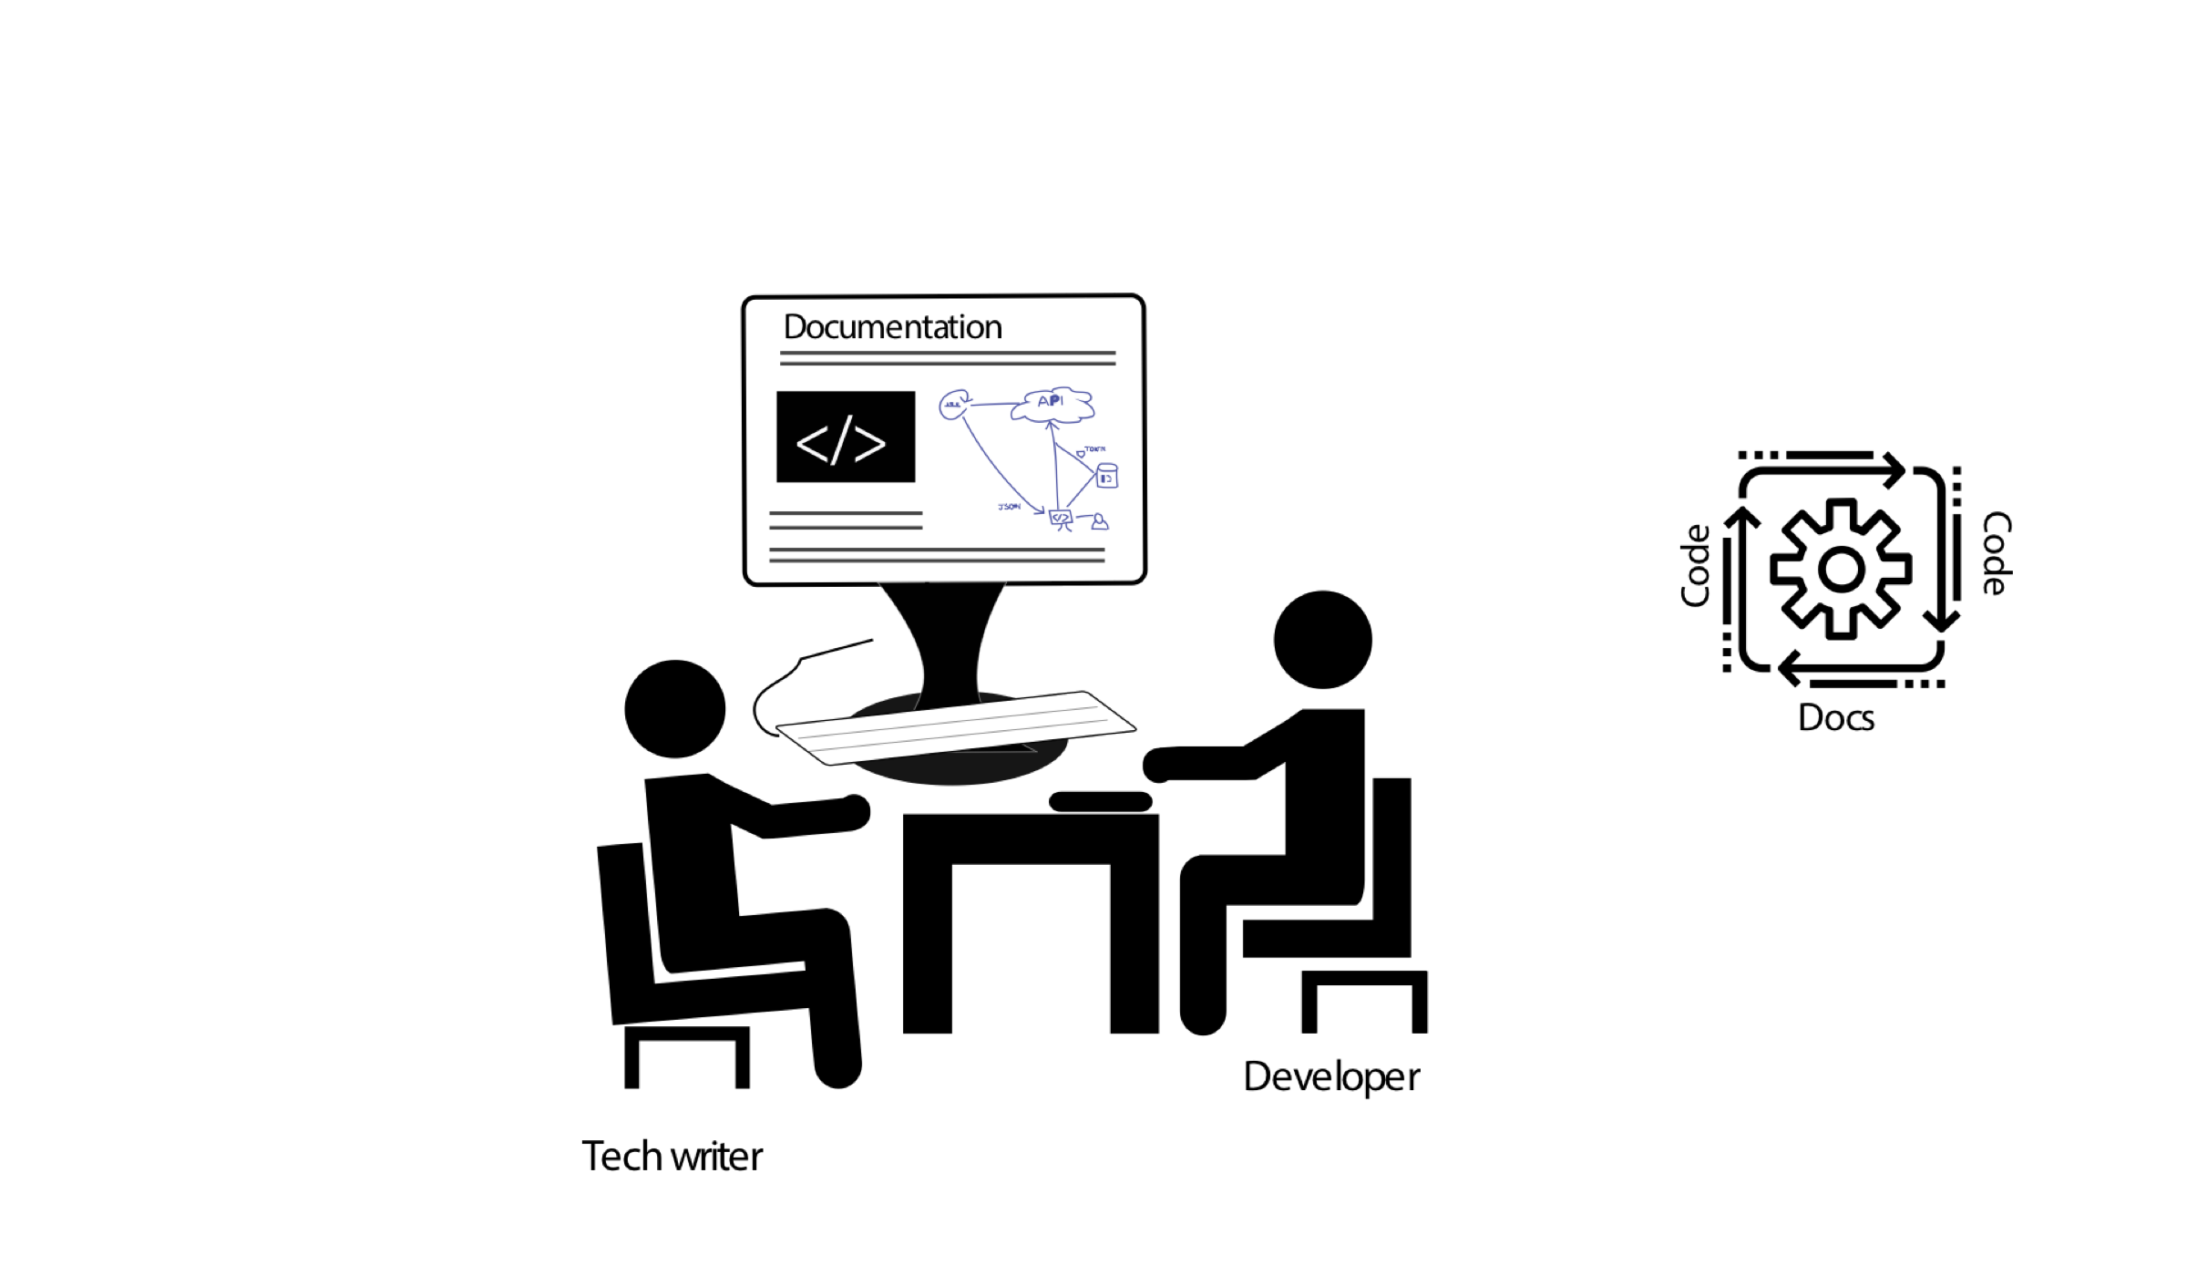
More collaboration in authoring specialized content

Slide 14

Questions

Slide 15
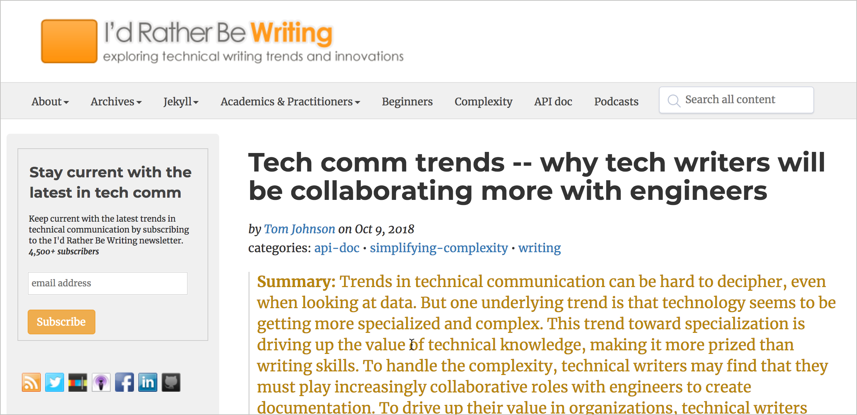
Where to get more info

Slide 16
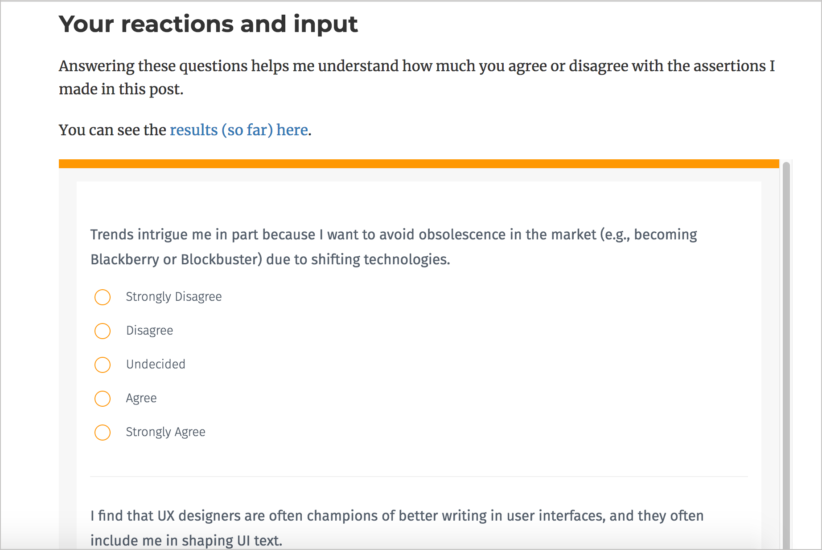
Agree/disagree survey

Slide 17

About me
Tom Johnson — idratherbewriting.com — @tomjohnson — tomjoht@gmail.com

